Slide 1
CSCI 347 Data Mining
Graph Data

Slide 2
Graph Data
Data instances are often not entirely independent
they can be interconnected through various types of relationships.
Graph data or networks are a data structure where instances are depicted as nodes, and the connections between these instances are represented by edges.

Slide 3
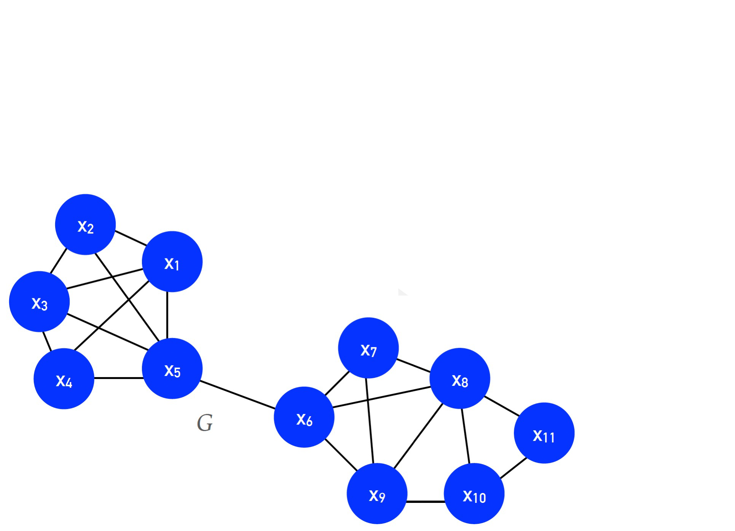

Graph Data
$$G=\left(V, E\right)$$
$$V=set of vertices$$
$$E⊆V×V, is the set of vertices in the graph$$

Slide 4
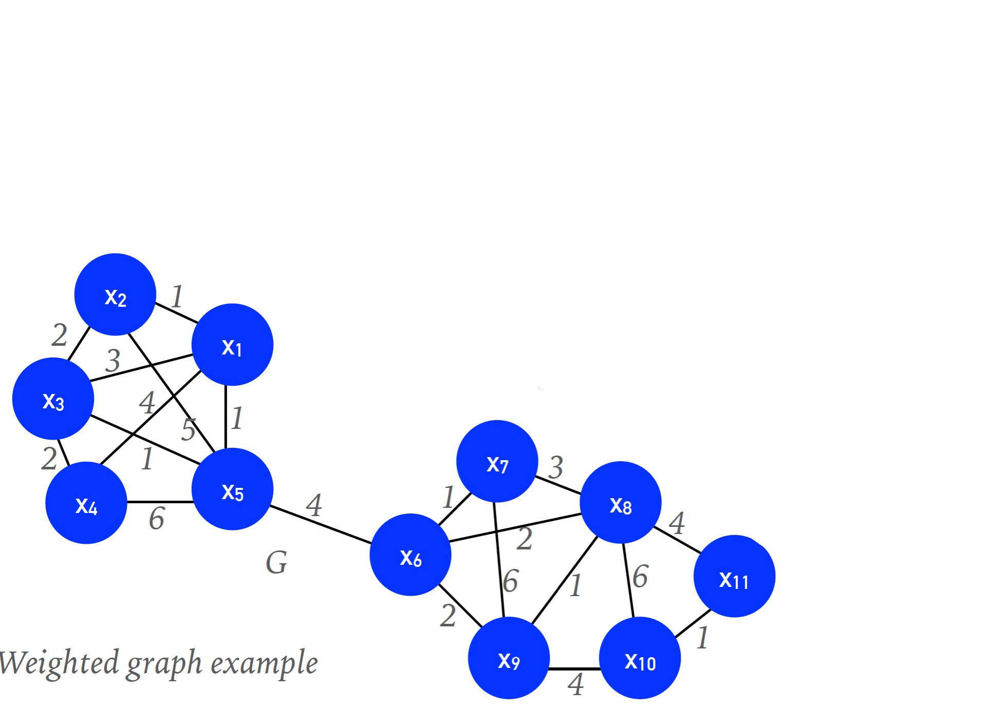
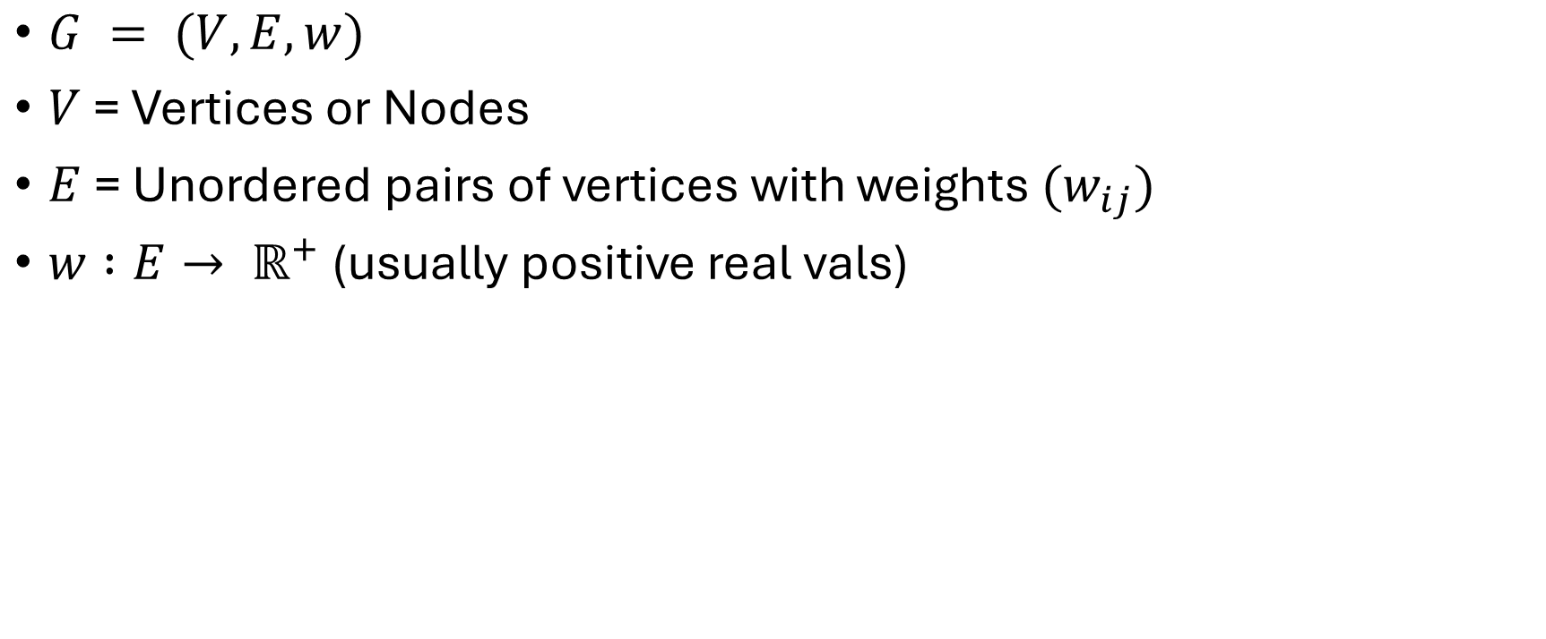
Graph Data (Weighted graph)
$G = (V, E, w)$
$V$ = Vertices or Nodes
$E$ = Unordered pairs of vertices with weights $(w_{ij})$
$w :E→ ℝ^{+}$ (usually positive real vals)

Slide 5
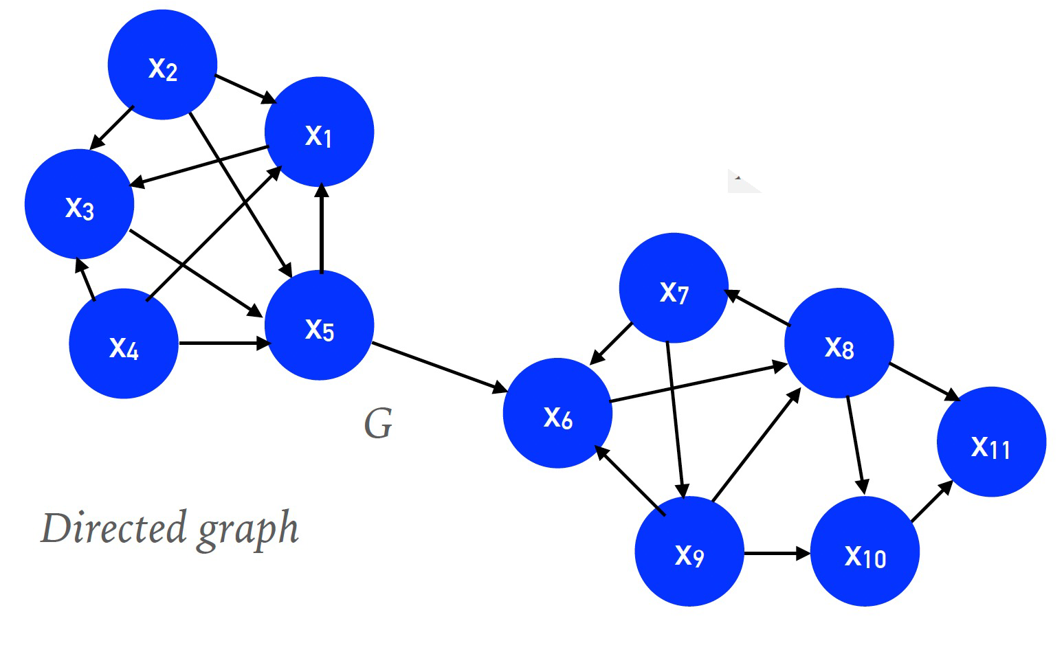
Graph Data (Directed Graph)
G = (V, E)
V = Vertices or Nodes
E = ordered pairs of vertices.

Slide 6
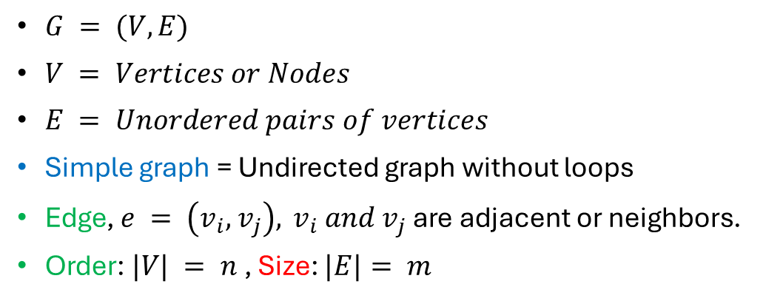
Graph Data
$G = (V, E)$
$V = Vertices or Nodes$
$E = Unordered pairs of vertices$
Simple graph = Undirected graph without loops
Edge, $e = \left(v_{i}, { v}_{j}\right),{ v}_{i} and v_{j}$ are adjacent or neighbors.
Order: $|V| = n$, Size: $|E|= m$

Slide 7
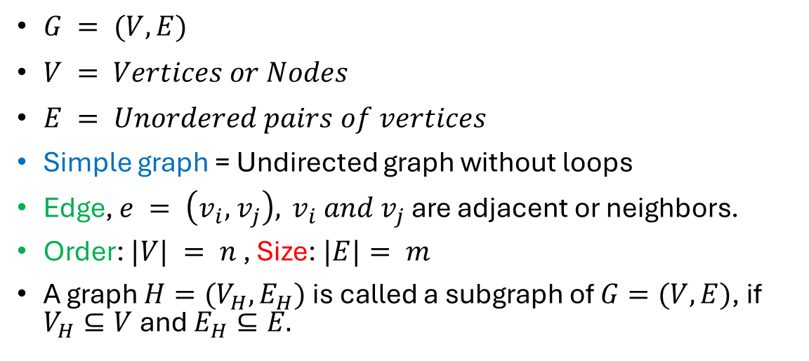
Graph Data
$G = (V, E)$
$V = Vertices or Nodes$
$E = Unordered pairs of vertices$
Simple graph = Undirected graph without loops
Edge, $e = \left(v_{i}, { v}_{j}\right),{ v}_{i} and v_{j}$ are adjacent or neighbors.
Order: $|V| = n$, Size: $|E|= m$
A graph $H=(V_{H}, E_{H})$ is called a subgraph of $G=(V, E)$, if $V_{H}⊆V$ and $E_{H}⊆E.$

Slide 8
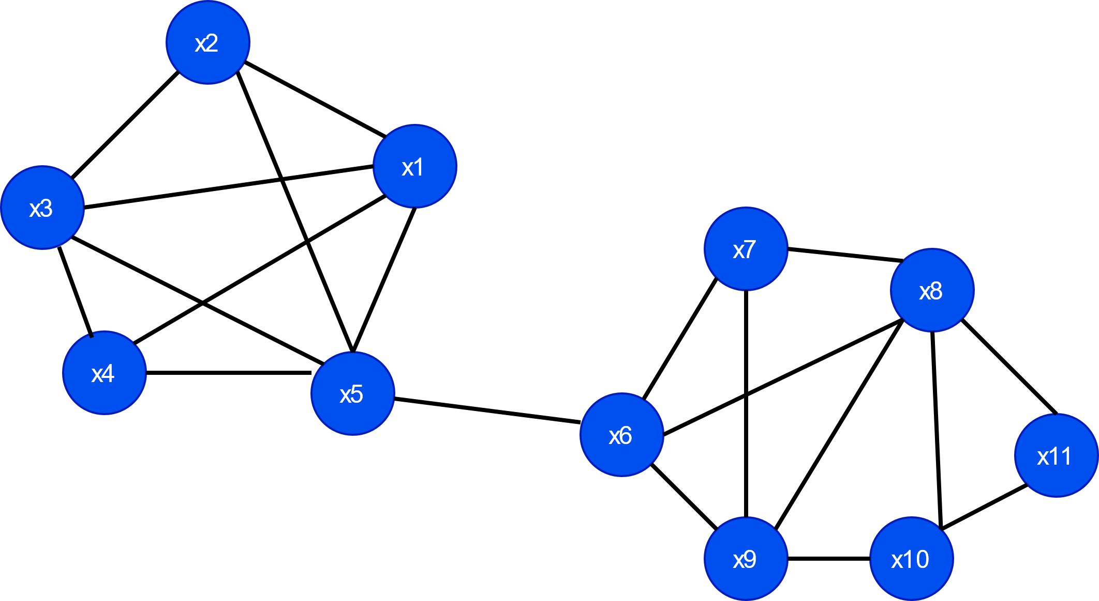
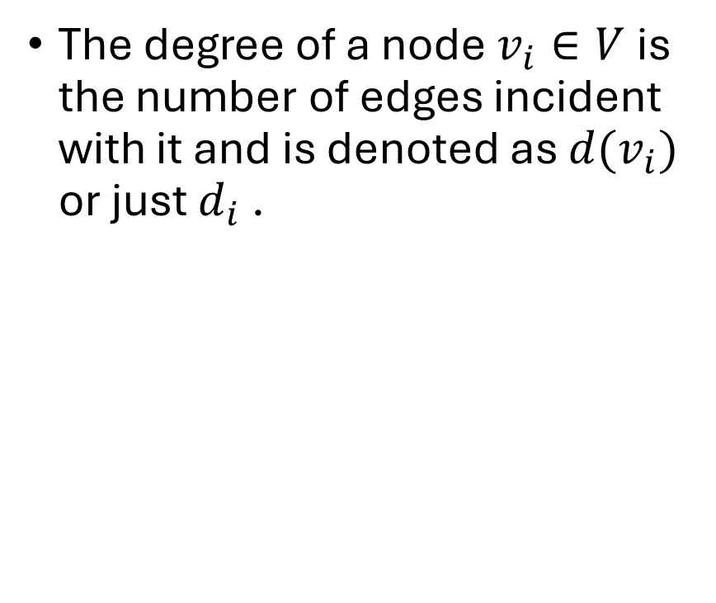
Degree of a node
The degree of a node $v_{i}∈V$is the number of edges incident with it and is denoted as $d(v_{i})$ or just $d_{i}$ .

Slide 9
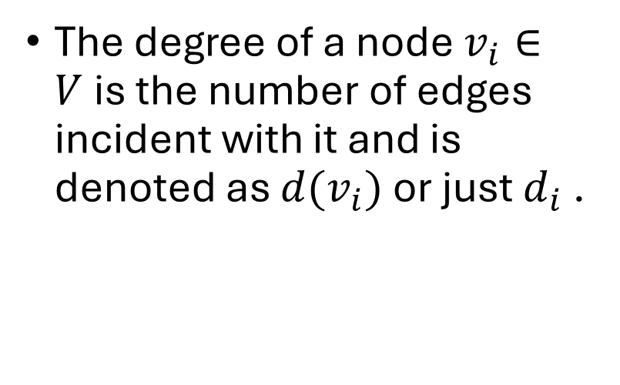
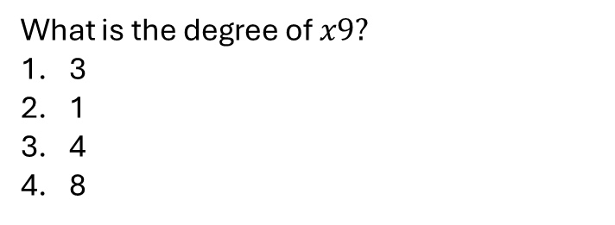
Degree of a node
The degree of a node $v_{i}∈V$is the number of edges incident with it and is denoted as $d(v_{i})$ or just $d_{i}$ .
What is the degree of $x9?$
3
1
4
8

Slide 10
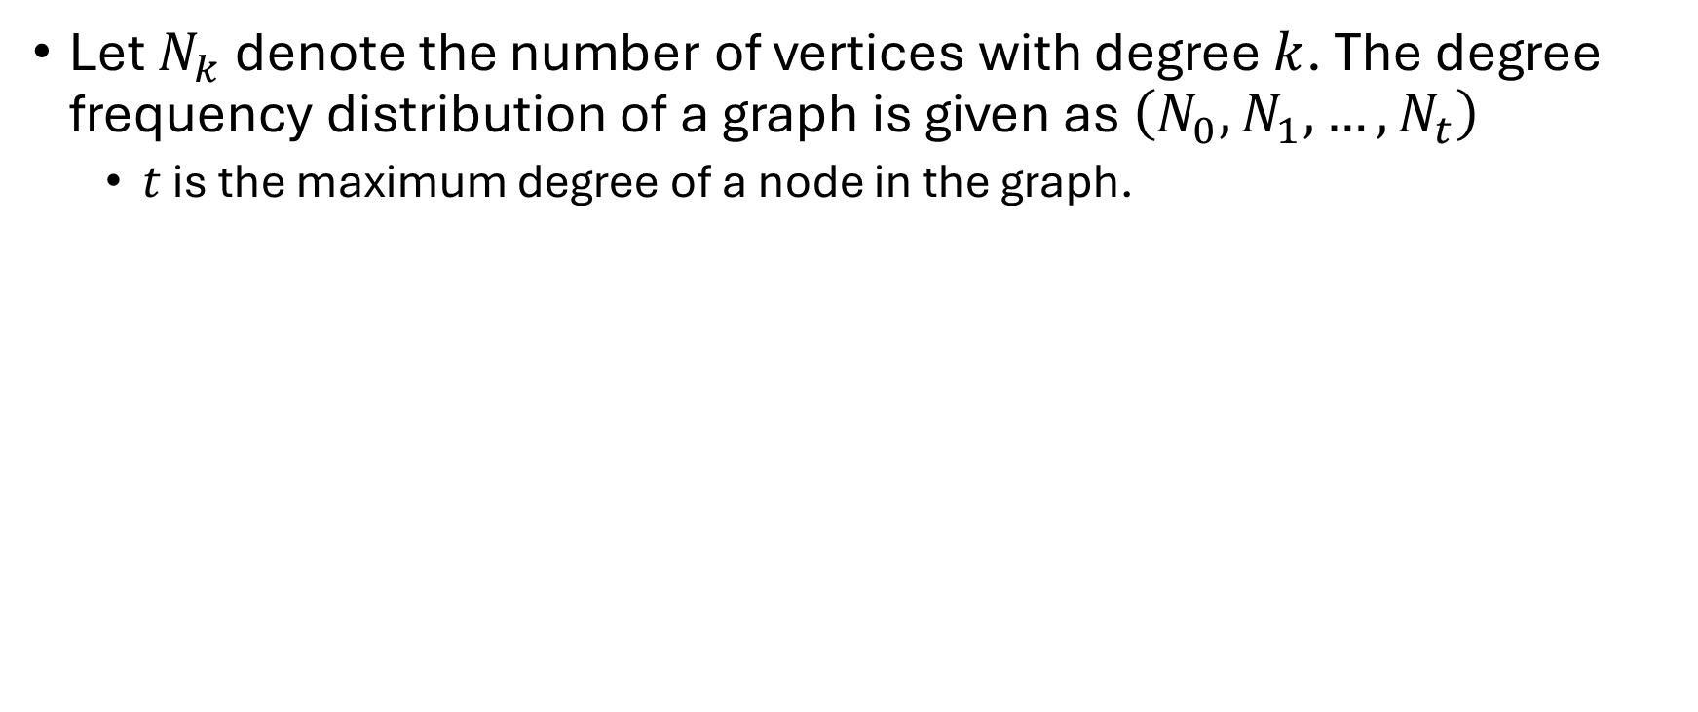
Degree Distribution
Let $N_{k}$ denote the number of vertices with degree $k$. The degree frequency distribution of a graph is given as $\left(N_{0},N_{1},…, N_{t}\right)$
$t$ is the maximum degree of a node in the graph.

Slide 11
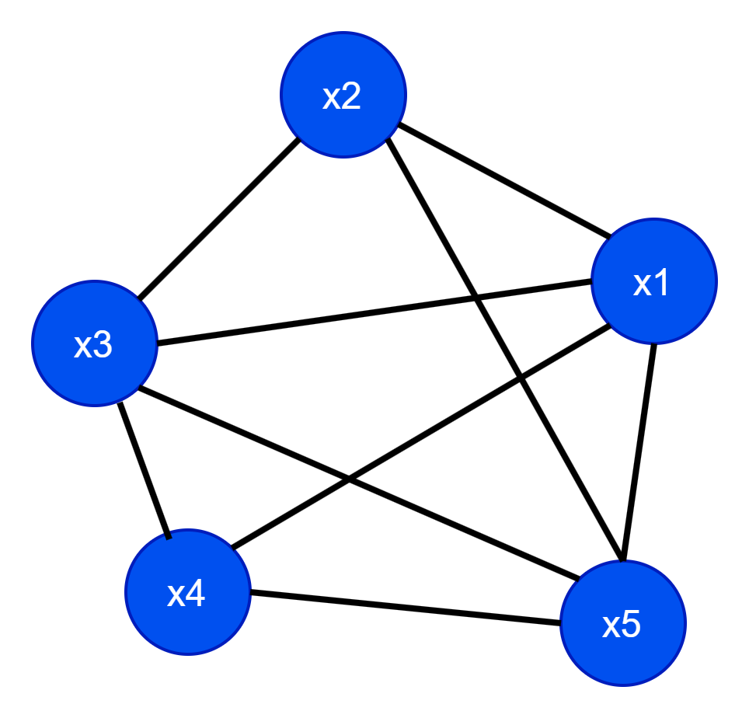
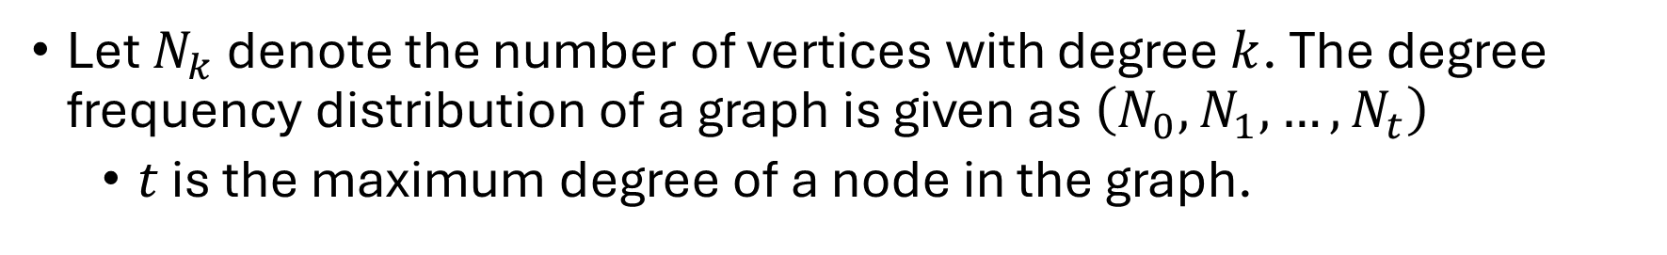
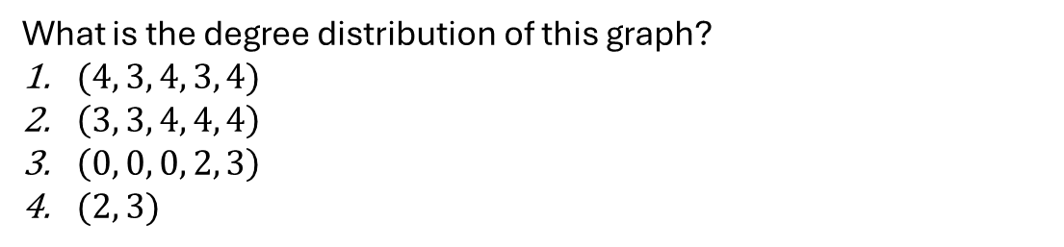
Degree Distribution
Let $N_{k}$ denote the number of vertices with degree $k$. The degree frequency distribution of a graph is given as $\left(N_{0},N_{1},…, N_{t}\right)$
$t$ is the maximum degree of a node in the graph.
What is the degree distribution of this graph?
$(4, 3, 4, 3, 4)$
$\left(3, 3, 4, 4, 4\right)$
$\left(0, 0, 0, 2, 3\right)$
$(2, 3)$

Slide 12
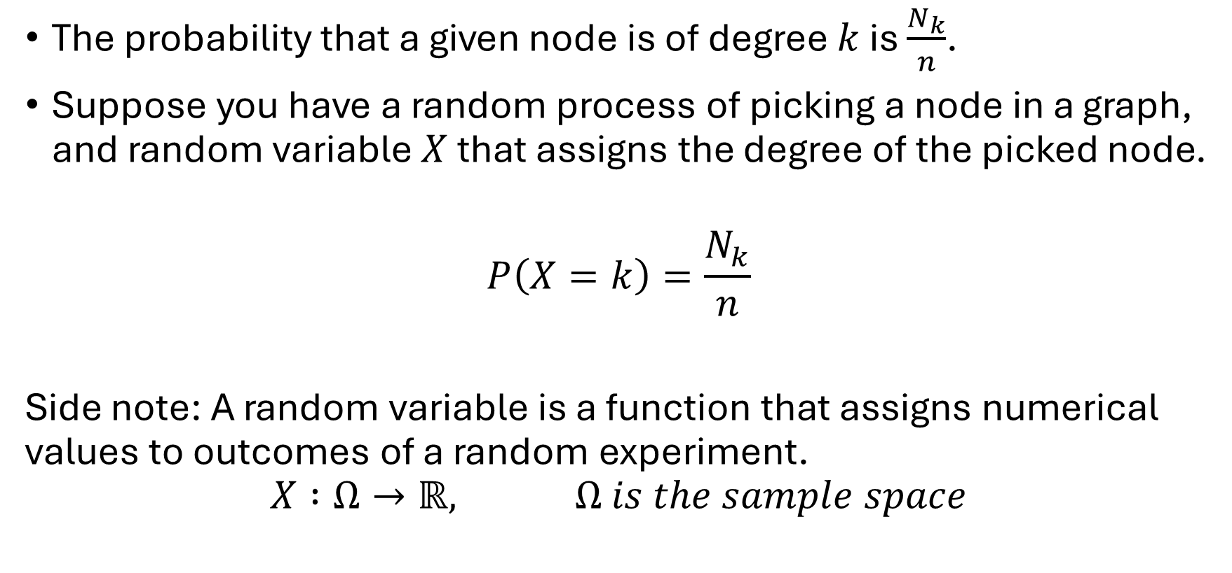
Degree Distribution
The probability that a given node is of degree $k$ is $\frac{N_{k}}{n}$.
Suppose you have a random process of picking a node in a graph, and random variable $X$ that assigns the degree of the picked node.
$$P\left(X=k\right)=\frac{N_{k}}{n}$$
Side note: A random variable is a function that assigns numerical values to outcomes of a random experiment.
$$X :Ω→ℝ, Ω is the sample space$$

Slide 13
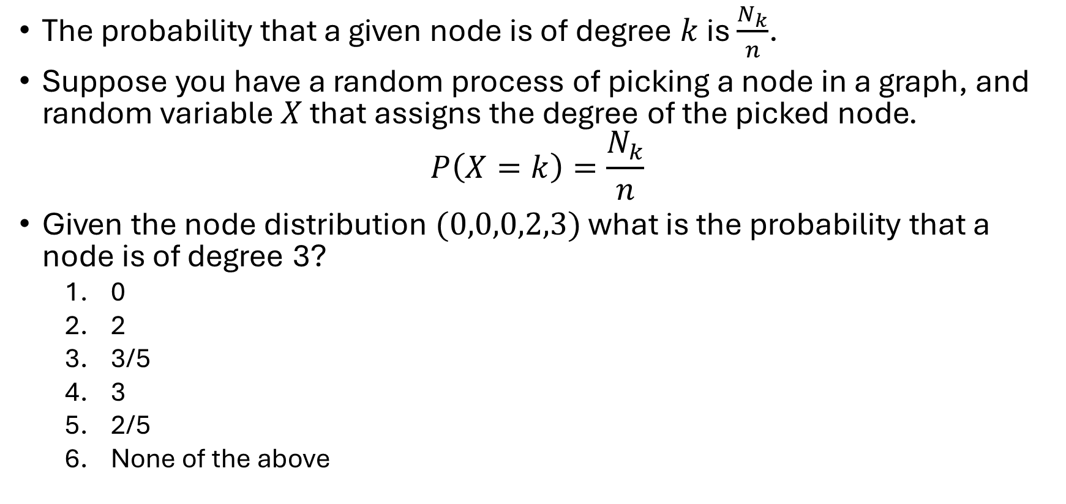
Degree Distribution
The probability that a given node is of degree $k$ is $\frac{N_{k}}{n}$.
Suppose you have a random process of picking a node in a graph, and random variable $X$ that assigns the degree of the picked node.
$$P\left(X=k\right)=\frac{N_{k}}{n}$$
Given the node distribution $(0,0,0,2,3)$ what is the probability that a node is of degree 3?
0
2
3/5
3
2/5
None of the above

Slide 14
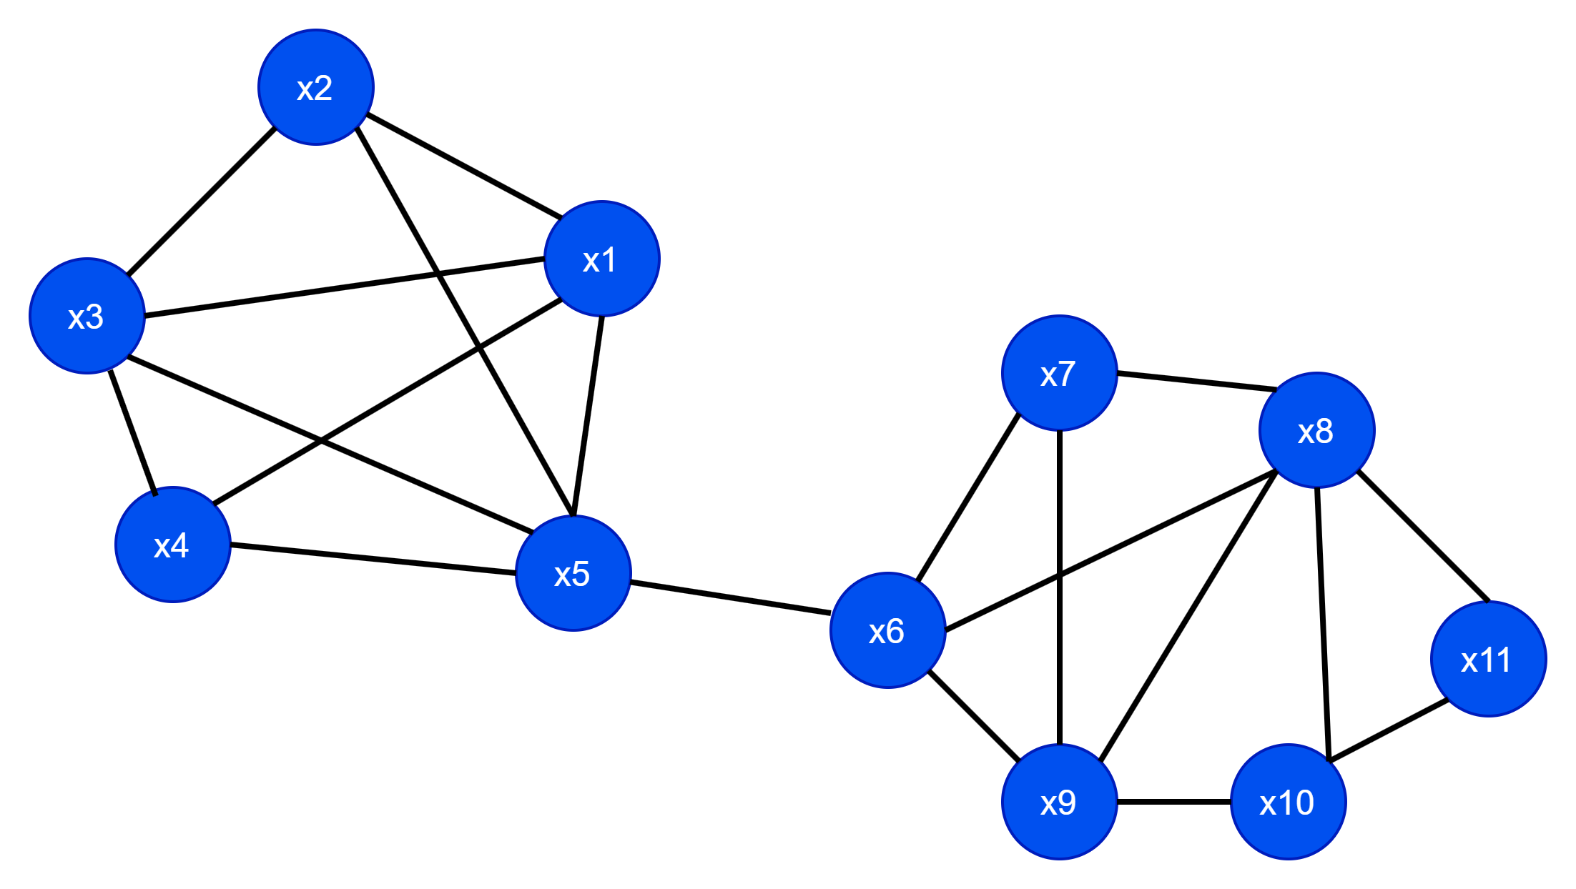
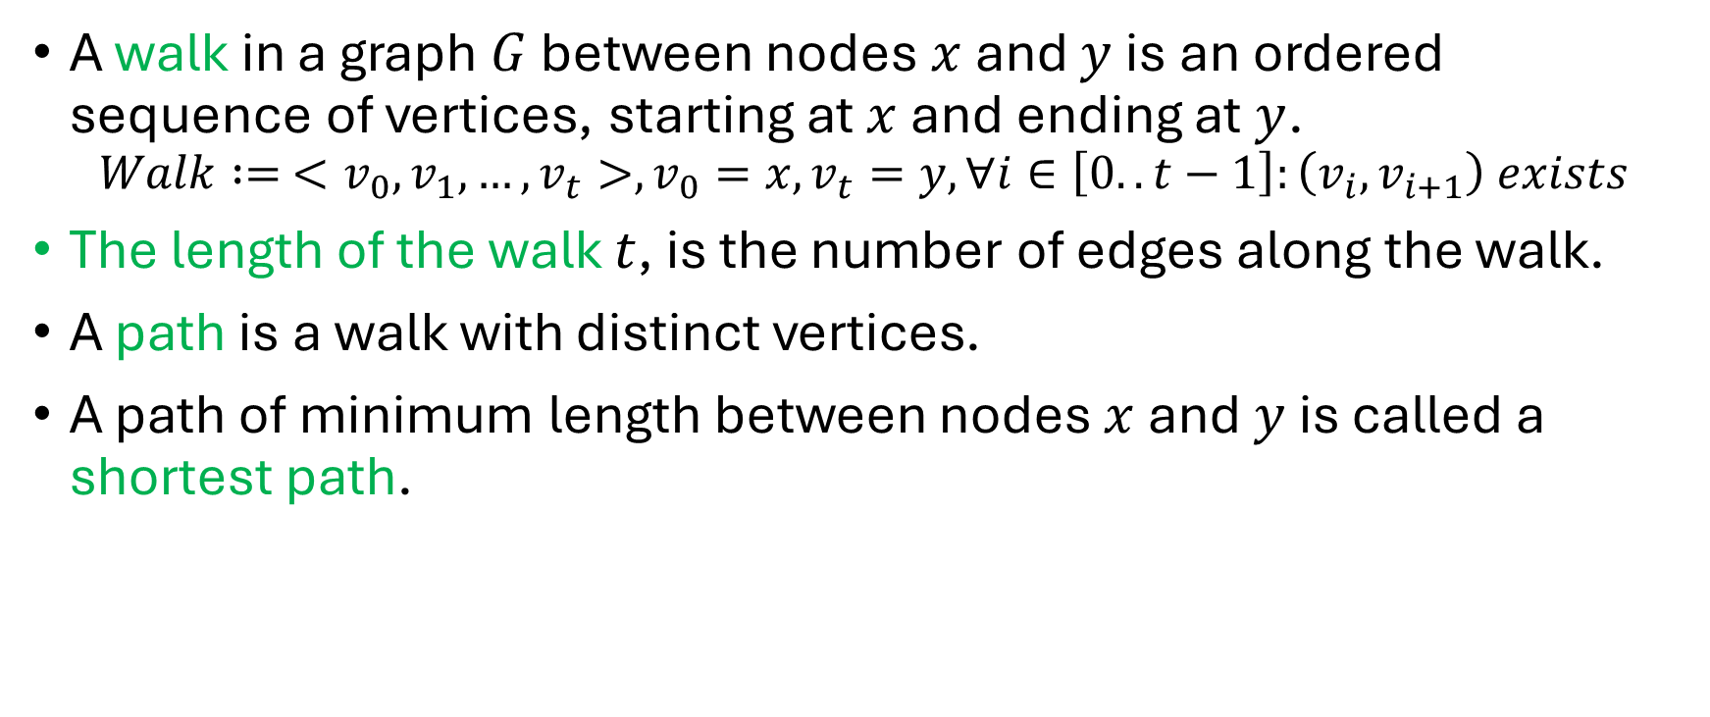
Walk, Path, shortest path
A walk in a graph $G$ between nodes $x$ and $y$ is an ordered sequence of vertices, starting at $x$ and ending at $y$.
$$Walk := <v_{0},v_{1},…,v_{t}>,v_{0}=x, v_{t}=y, ∀i∈\left[0..t−1\right]:\left(v_{i},v_{i+1}\right) exists$$
The length of the walk $t$, is the number of edges along the walk.
A path is a walk with distinct vertices.
A path of minimum length between nodes $x$ and $y$ is called a shortest path.

Slide 15
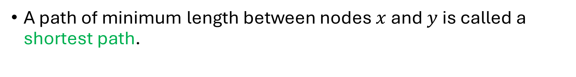
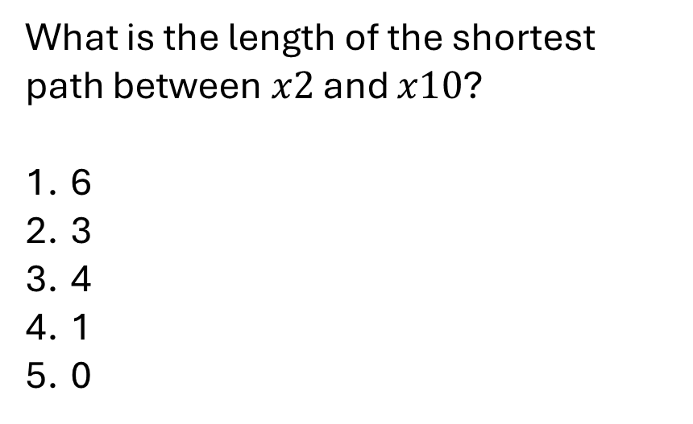
Walk, Path, shortest path
A path of minimum length between nodes $x$ and $y$ is called a shortest path.
What is the length of the shortest path between $x2$ and $x10$?
6
3
4
1
0

Slide 16
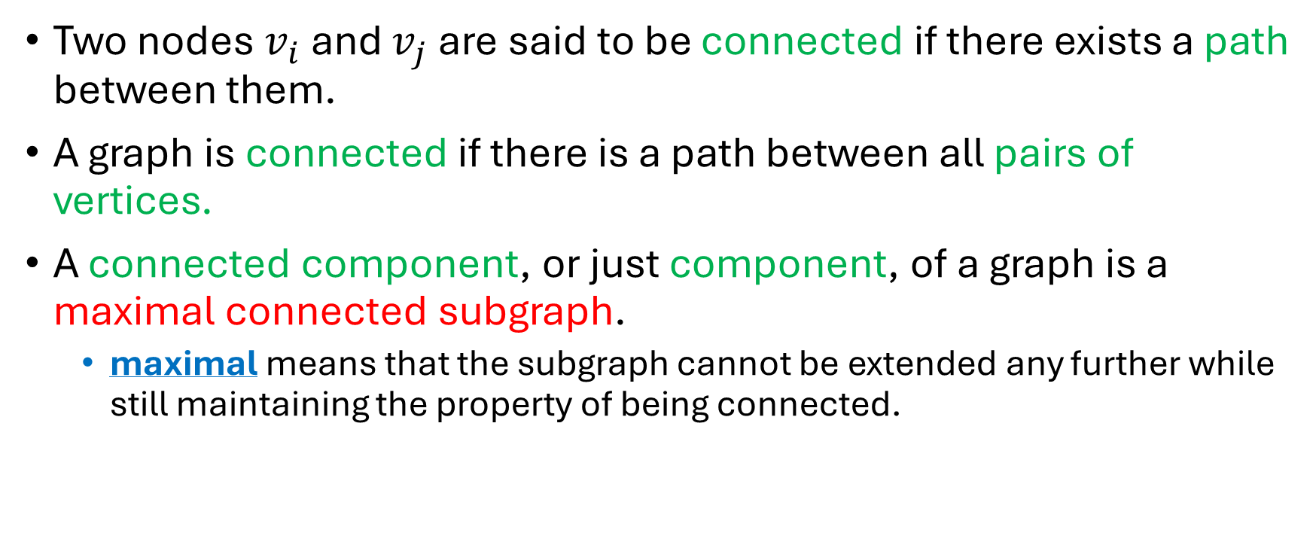
Connectedness
Two nodes $v_{i}$ and $v_{j}$ are said to be connected if there exists a path between them.
A graph is connected if there is a path between all pairs of vertices.
A connected component, or just component, of a graph is a maximal connected subgraph.
maximal means that the subgraph cannot be extended any further while still maintaining the property of being connected.

Slide 17
Connectedness
Is this graph connected?
Yes
No

Slide 18
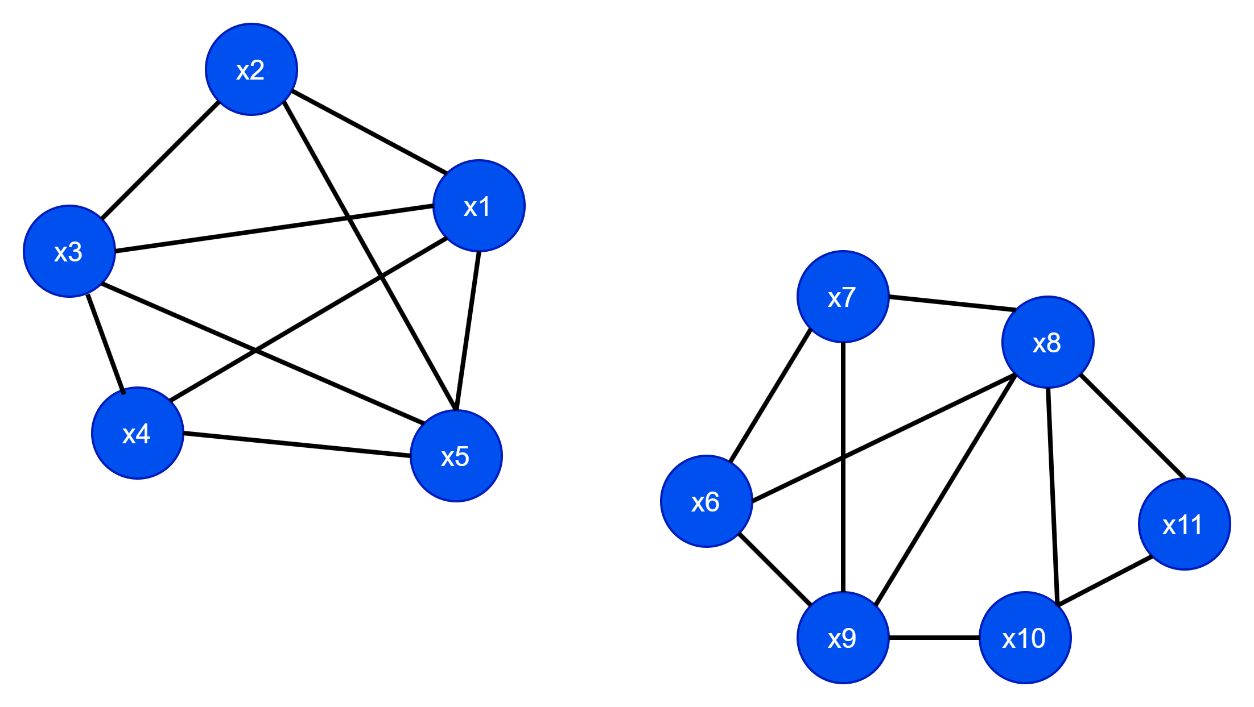
Connectedness
Is this graph connected?
Yes
No

Slide 19
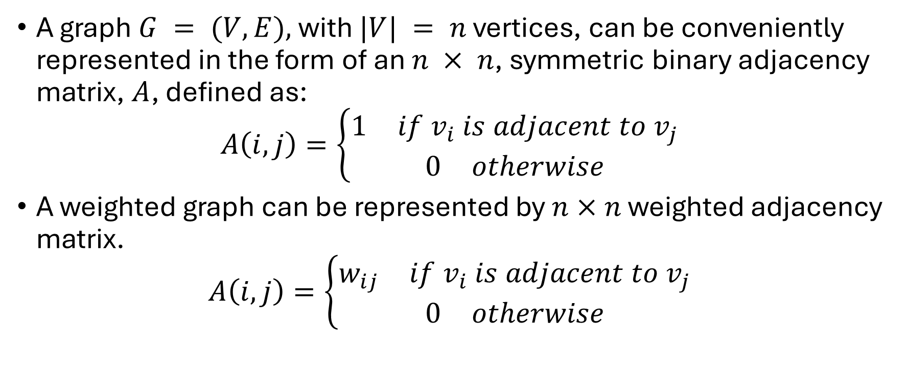
Adjacency Matrix
A graph $G = (V,E),$with $|V| = n$ vertices, can be conveniently represented in the form of an $n × n$, symmetric binary adjacency matrix, $A$, defined as:
$$A\left(i,j\right)=\left\{\begin{aligned}\begin{matrix}1 & if v_{i} is adjacent to v_{j}\end{matrix} \\ \begin{matrix}0 & otherwise\end{matrix}\end{aligned}\right.$$
A weighted graph can be represented by $n×n$ weighted adjacency matrix.
$$A\left(i,j\right)=\left\{\begin{aligned}\begin{matrix}w_{ij} & if v_{i} is adjacent to v_{j}\end{matrix} \\ \begin{matrix}0 & otherwise\end{matrix}\end{aligned}\right.$$

Slide 20

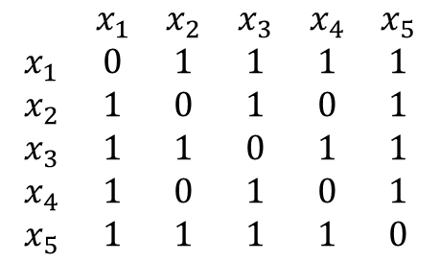
Adjacency matrix example.
$$\begin{matrix} & x_{1} & x_{2} & x_{3} & x_{4} & x_{5} \\ x_{1} & 0 & 1 & 1 & 1 & 1 \\ x_{2} & 1 & 0 & 1 & 0 & 1 \\ x_{3} & 1 & 1 & 0 & 1 & 1 \\ x_{4} & 1 & 0 & 1 & 0 & 1 \\ x_{5} & 1 & 1 & 1 & 1 & 0\end{matrix}$$

Slide 21
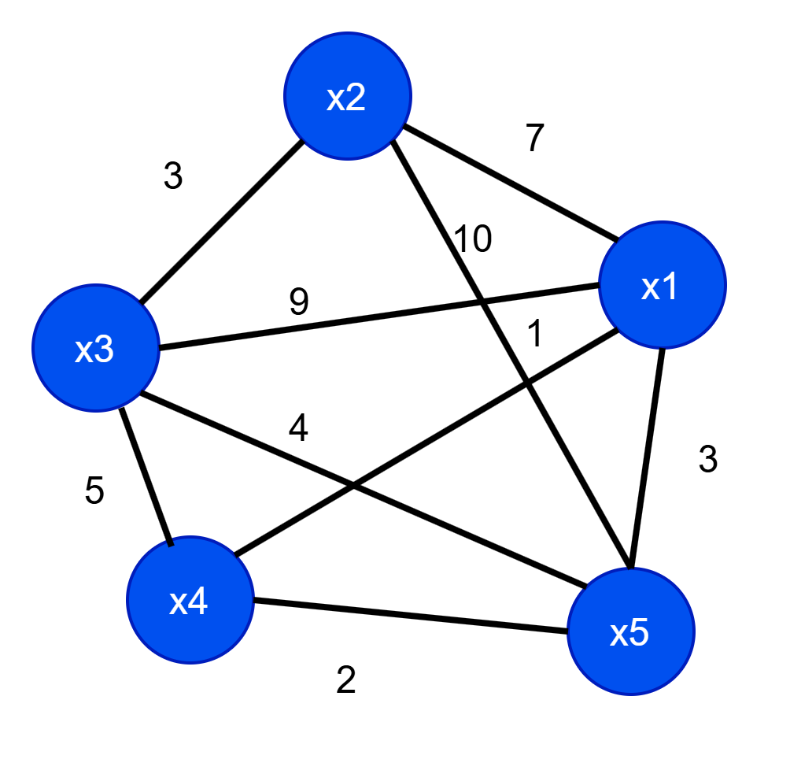
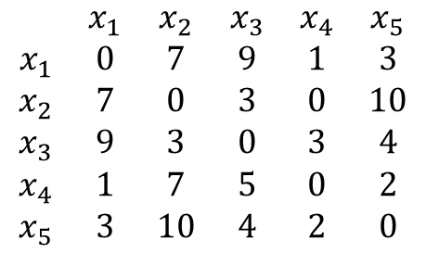
Adjacency matrix (weighted) example.
$$\begin{matrix} & x_{1} & x_{2} & x_{3} & x_{4} & x_{5} \\ x_{1} & 0 & 7 & 9 & 1 & 3 \\ x_{2} & 7 & 0 & 3 & 0 & 10 \\ x_{3} & 9 & 3 & 0 & 3 & 4 \\ x_{4} & 1 & 7 & 5 & 0 & 2 \\ x_{5} & 3 & 10 & 4 & 2 & 0\end{matrix}$$

Slide 22
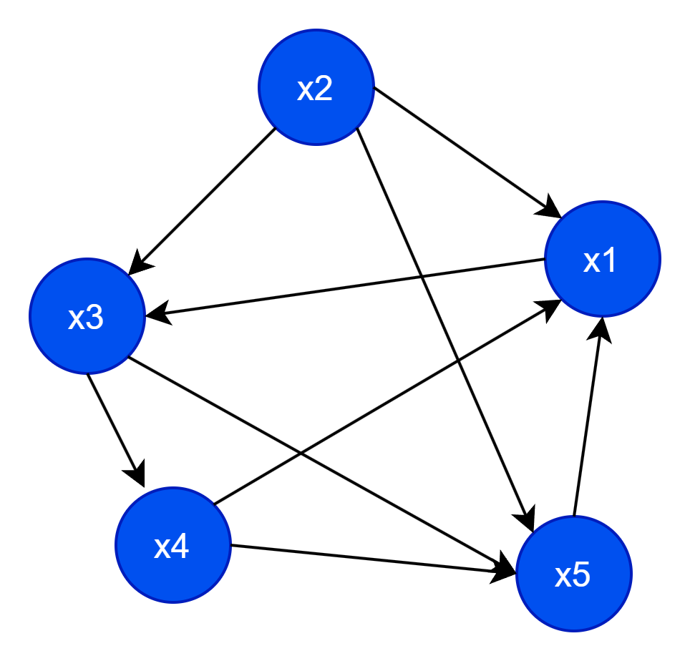
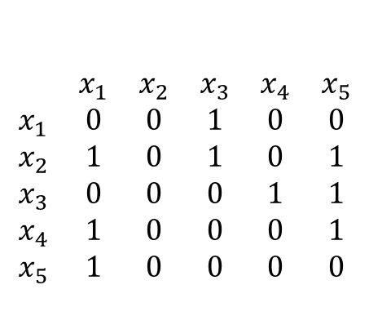
Adjacency matrix: directed graph
In a directed graph adjacency matrix is not symmetric.
$$\begin{matrix} & x_{1} & x_{2} & x_{3} & x_{4} & x_{5} \\ x_{1} & 0 & 0 & 1 & 0 & 0 \\ x_{2} & 1 & 0 & 1 & 0 & 1 \\ x_{3} & 0 & 0 & 0 & 1 & 1 \\ x_{4} & 1 & 0 & 0 & 0 & 1 \\ x_{5} & 1 & 0 & 0 & 0 & 0\end{matrix}$$

Slide 23

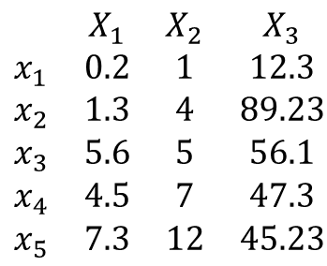

Graphs from Data Matrix
Given a dataset in the form of a matrix, can we create a graph?
$$\begin{matrix} & X_{1} & X_{2} & X_{3} \\ x_{1} & 0.2 & 1 & 12.3 \\ x_{2} & 1.3 & 4 & 89.23 \\ x_{3} & 5.6 & 5 & 56.1 \\ x_{4} & 4.5 & 7 & 47.3 \\ x_{5} & 7.3 & 12 & 45.23\end{matrix}$$
$$?$$
But what can we do about the edges?

Slide 24
Graphs from Data Matrix
Given a dataset in the form of a matrix, can we create a graph?
$$\begin{matrix} & X_{1} & X_{2} & X_{3} \\ x_{1} & 0.2 & 1 & 12.3 \\ x_{2} & 1.3 & 4 & 89.23 \\ x_{3} & 5.6 & 5 & 56.1 \\ x_{4} & 4.5 & 7 & 47.3 \\ x_{5} & 7.3 & 12 & 45.23\end{matrix}$$
$$?$$
How about we using a similarity measure and then use the similarity measure as the edge weights?

Slide 25
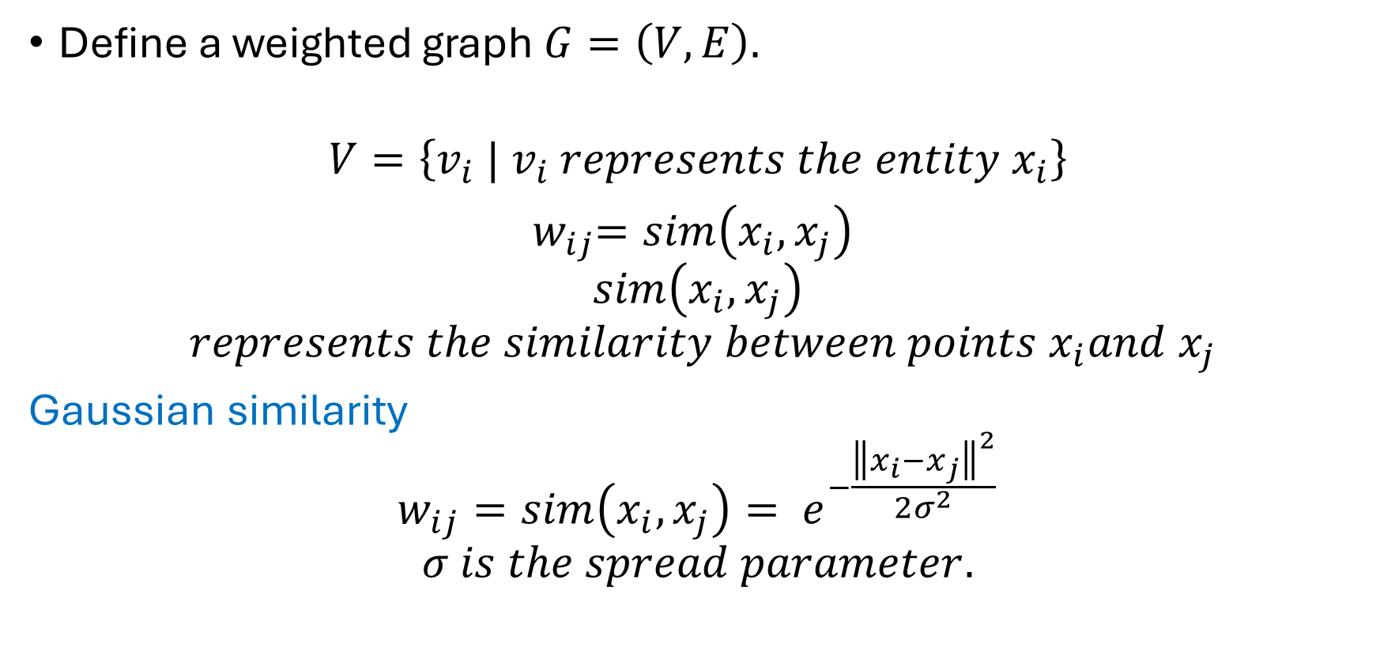
How to create a graph from matrix?
Define a weighted graph $G=\left(V,E\right).$
$$V=\left\{v_{i} | v_{i} represents the entity x_{i}\right\}$$
${ w}_{ij}=sim\left(x_{i}, x_{j}\right)$
$$sim\left(x_{i}, x_{j}\right)$$
$$represents the similarity between points x_{i}and x_{j}$$
Gaussian similarity
$$w_{ij}=sim\left(x_{i}, x_{j}\right)= e^{−\frac{{\left\|x_{i}−x_{j}\right\|}^{2}}{2σ^{2}}}$$
$$σ is the spread parameter.$$

Slide 26
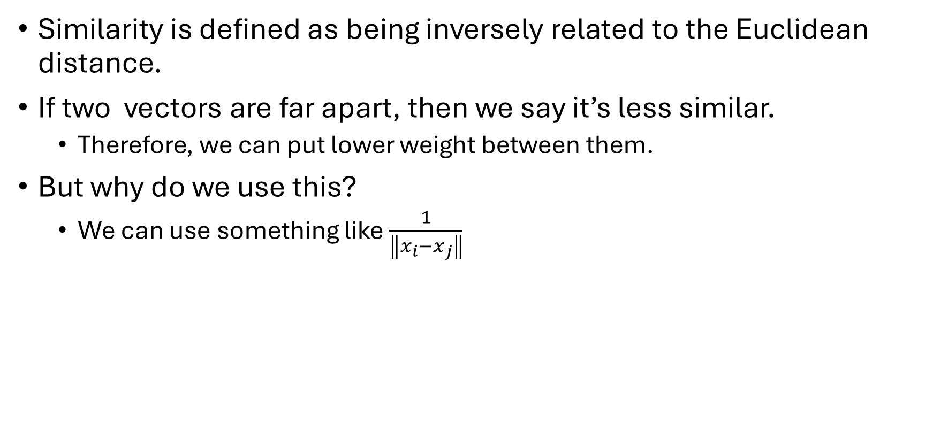
Gaussian similarity
Similarity is defined as being inversely related to the Euclidean distance.
If two vectors are far apart, then we say it’s less similar.
Therefore, we can put lower weight between them.
But why do we use this?
We can use something like $\frac{1}{\left\|x_{i}−x_{j}\right\|}$

Slide 27
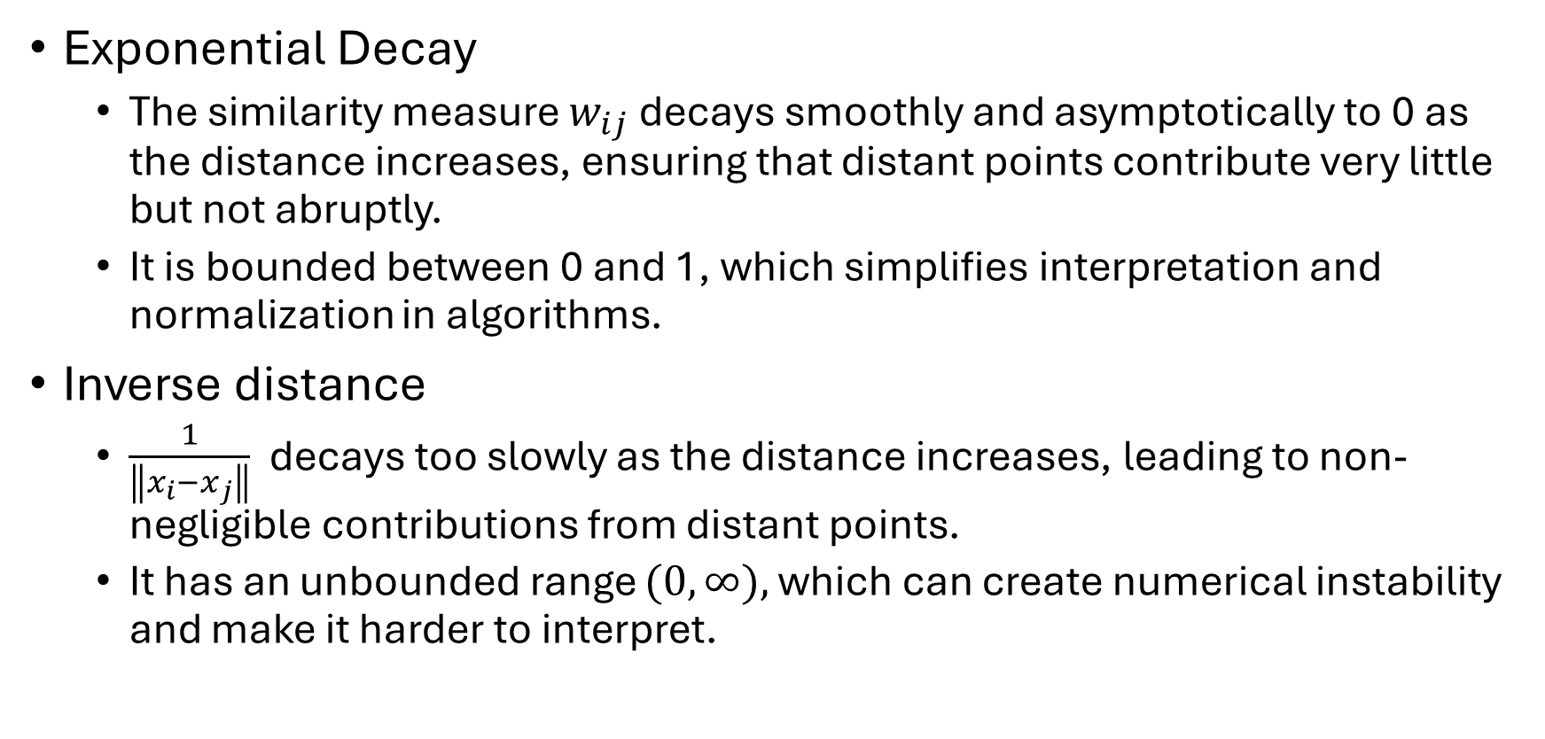
Gaussian similarity
Exponential Decay
The similarity measure $w_{ij}$ decays smoothly and asymptotically to 0 as the distance increases, ensuring that distant points contribute very little but not abruptly.
It is bounded between 0 and 1, which simplifies interpretation and normalization in algorithms.
Inverse distance
$\frac{1}{\left\|x_{i}−x_{j}\right\|}$ decays too slowly as the distance increases, leading to non-negligible contributions from distant points.
It has an unbounded range $(0,∞),$which can create numerical instability and make it harder to interpret.

Slide 28
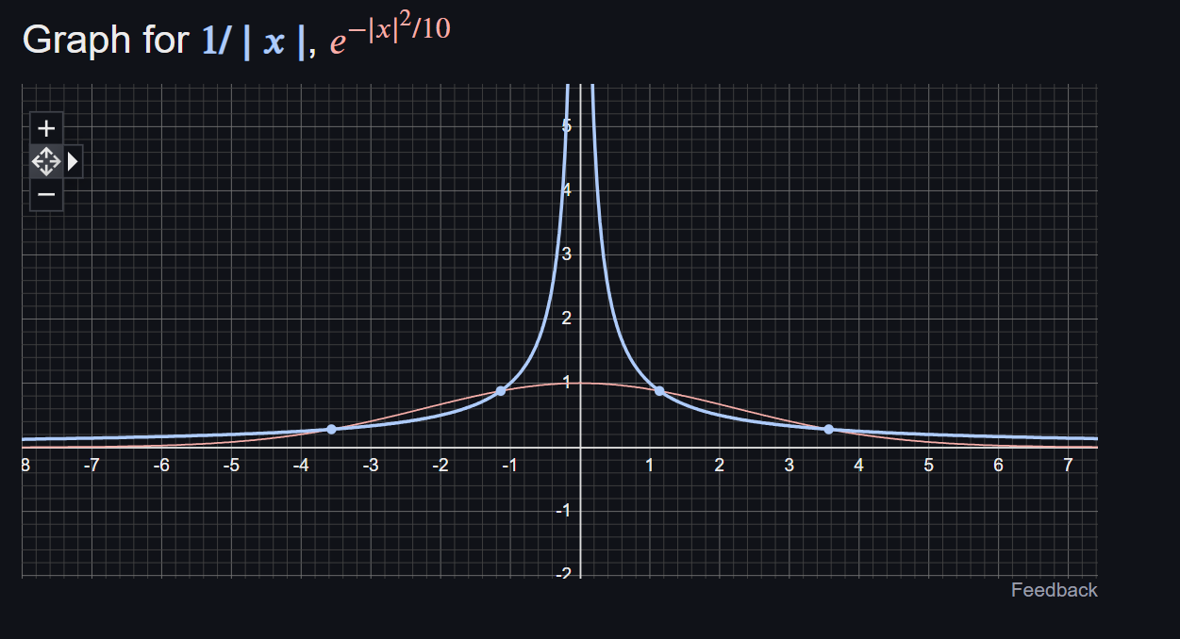

Slide 29
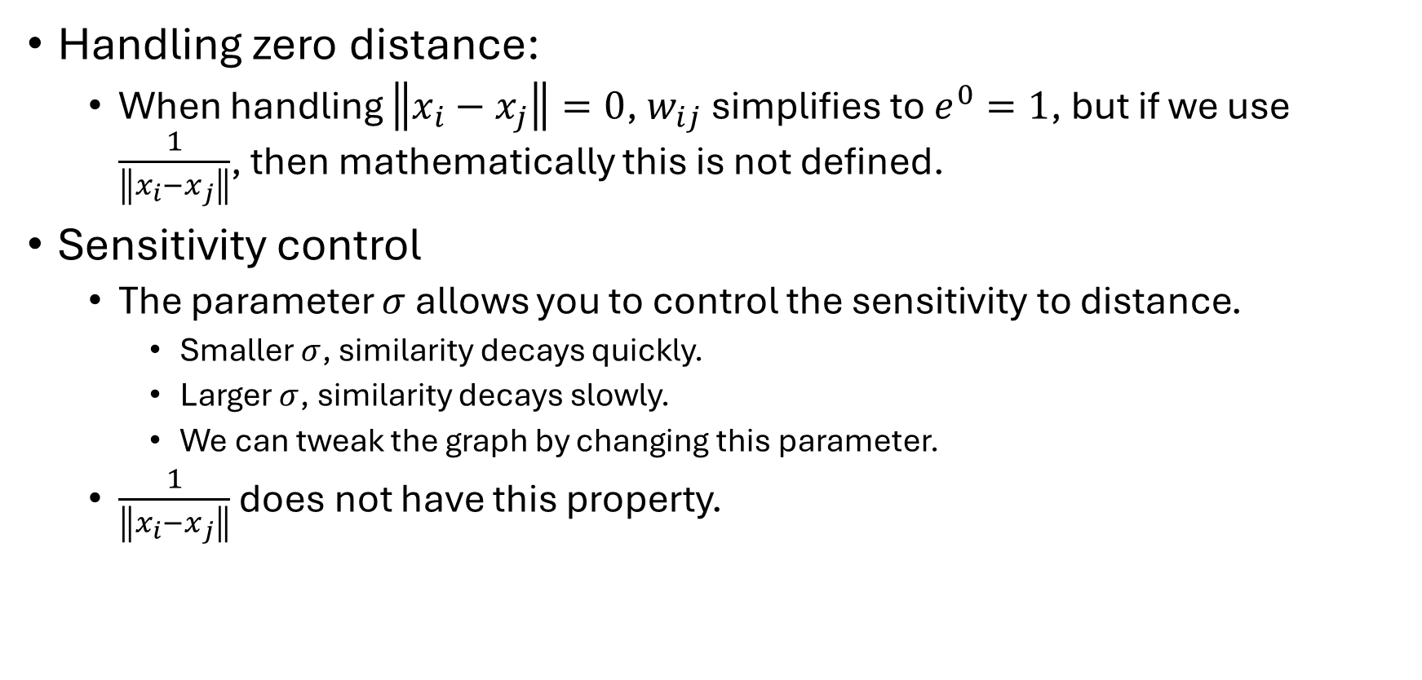
Gaussian similarity
Handling zero distance:
When handling $\left\|x_{i}−x_{j}\right\|=0$, $w_{ij}$ simplifies to $e^{0}=1$, but if we use $\frac{1}{\left\|x_{i}−x_{j}\right\|}$, then mathematically this is not defined.
Sensitivity control
The parameter $σ$ allows you to control the sensitivity to distance.
Smaller $σ$, similarity decays quickly.
Larger $σ$, similarity decays slowly.
We can tweak the graph by changing this parameter.
$\frac{1}{\left\|x_{i}−x_{j}\right\|}$ does not have this property.

Slide 30
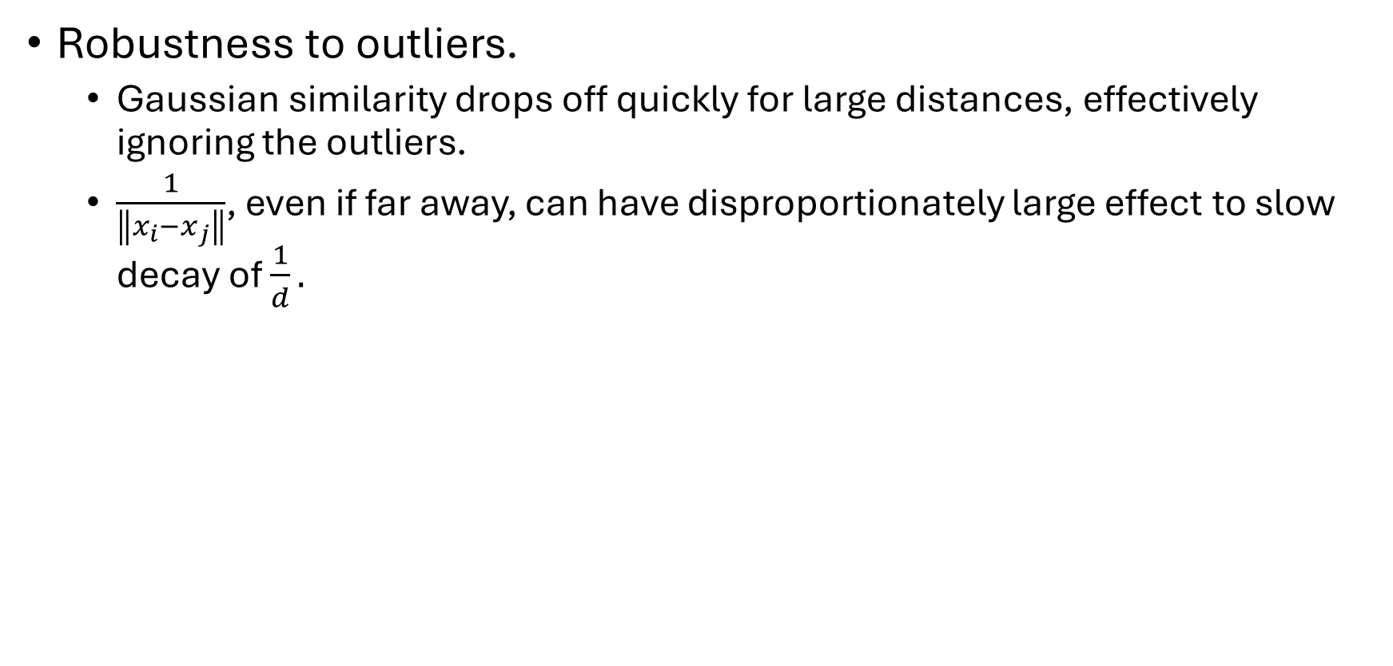
Gaussian similarity
Robustness to outliers.
Gaussian similarity drops off quickly for large distances, effectively ignoring the outliers.
$\frac{1}{\left\|x_{i}−x_{j}\right\|}$, even if far away, can have disproportionately large effect to slow decay of $\frac{1}{d}.$

Slide 31
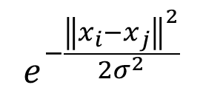
Graphs from Data Matrix
Gaussian similarity with $σ=25$
$$e^{−\frac{{\left\|x_{i}−x_{j}\right\|}^{2}}{2σ^{2}}}$$
$$\begin{matrix} & X_{1} & X_{2} & X_{3} \\ x_{1} & 0.2 & 1 & 12.3 \\ x_{2} & 1.3 & 4 & 89.23 \\ x_{3} & 5.6 & 5 & 56.1 \\ x_{4} & 4.5 & 7 & 47.3 \\ x_{5} & 7.3 & 12 & 45.23\end{matrix}$$
0 | 0.008709 | 0.207862 | 0.359302 | 0.366178
0.008709 | 0 | 0.409967 | 0.241611 | 0.196716
0.207862 | 0.409967 | 0 | 0.936019 | 0.87281
0.359302 | 0.241611 | 0.936019 | 0 | 0.970737
0.366178 | 0.196716 | 0.87281 | 0.970737 | 0

Slide 32
Graphs from Data Matrix
Gaussian similarity with $σ=25$
$$e^{−\frac{{\left\|x_{i}−x_{j}\right\|}^{2}}{2σ^{2}}}$$
$$\begin{matrix} & X_{1} & X_{2} & X_{3} \\ x_{1} & 0.2 & 1 & 12.3 \\ x_{2} & 1.3 & 4 & 89.23 \\ x_{3} & 5.6 & 5 & 56.1 \\ x_{4} & 4.5 & 7 & 47.3 \\ x_{5} & 7.3 & 12 & 45.23\end{matrix}$$
 | x1 | x2 | x3 | x4 | x5
x1 | 0 | 0.008709 | 0.207862 | 0.359302 | 0.366178
x2 | 0.008709 | 0 | 0.409967 | 0.241611 | 0.196716
x3 | 0.207862 | 0.409967 | 0 | 0.936019 | 0.87281
x4 | 0.359302 | 0.241611 | 0.936019 | 0 | 0.970737
x5 | 0.366178 | 0.196716 | 0.87281 | 0.970737 | 0

Slide 33
Graphs from Data Matrix
Gaussian similarity with $σ=50$
$$e^{−\frac{{\left\|x_{i}−x_{j}\right\|}^{2}}{2σ^{2}}}$$
$$\begin{matrix} & X_{1} & X_{2} & X_{3} \\ x_{1} & 0.2 & 1 & 12.3 \\ x_{2} & 1.3 & 4 & 89.23 \\ x_{3} & 5.6 & 5 & 56.1 \\ x_{4} & 4.5 & 7 & 47.3 \\ x_{5} & 7.3 & 12 & 45.23\end{matrix}$$
 | x1 | x2 | x3 | x4 | x5
x1 | 0 | 0.30549 | 0.675218 | 0.774221 | 0.777899
x2 | 0.30549 | 0 | 0.800179 | 0.701098 | 0.665978
x3 | 0.675218 | 0.800179 | 0 | 0.983606 | 0.966562
x4 | 0.774221 | 0.701098 | 0.983606 | 0 | 0.992603
x5 | 0.777899 | 0.665978 | 0.966562 | 0.992603 | 0

Slide 34
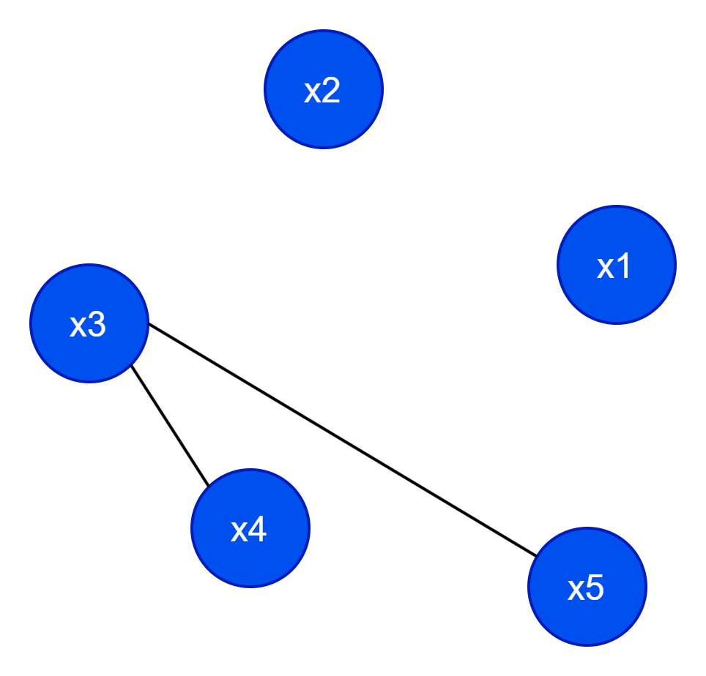
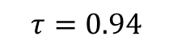
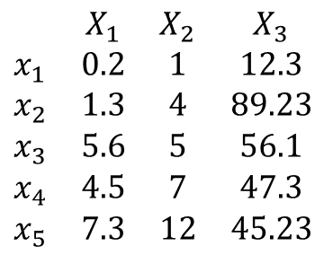


Creating a graph from matrix
$$τ=0.94$$
 | x1 | x2 | x3 | x4 | x5
x1 | 0 | 0.30549 | 0.675218 | 0.774221 | 0.777899
x2 | 0.30549 | 0 | 0.800179 | 0.701098 | 0.665978
x3 | 0.675218 | 0.800179 | 0 | 0.983606 | 0.966562
x4 | 0.774221 | 0.701098 | 0.983606 | 0 | 0.992603
x5 | 0.777899 | 0.665978 | 0.966562 | 0.992603 | 0
$$\begin{matrix} & X_{1} & X_{2} & X_{3} \\ x_{1} & 0.2 & 1 & 12.3 \\ x_{2} & 1.3 & 4 & 89.23 \\ x_{3} & 5.6 & 5 & 56.1 \\ x_{4} & 4.5 & 7 & 47.3 \\ x_{5} & 7.3 & 12 & 45.23\end{matrix}$$
 | x1 | x2 | x3 | x4 | x5
x1 | 0 | 0 | 0 | 0 | 0
x2 | 0 | 0 | 0 | 0 | 0
x3 | 0 | 0 | 0 | 1 | 1
x4 | 0 | 0 | 1 | 0 | 1
x5 | 0 | 0 | 1 | 1 | 0
$$sim(x_{i}, x_{j})=e^{−\frac{{\left\|x_{i}−x_{j}\right\|}^{2}}{2σ^{2}}}$$
$$A\left(i,j\right)=\left\{\begin{aligned}\begin{matrix}1 & ifsim\left(x_{i}, x_{j}\right)≥τ\end{matrix} \\ \begin{matrix}0 & otherwise \end{matrix}\end{aligned}\right.$$

Slide 35
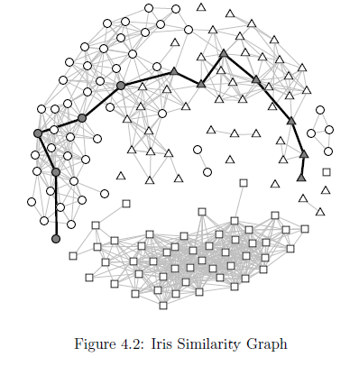
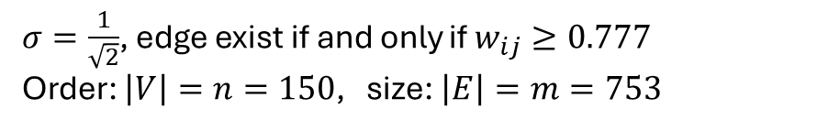
Iris Similarity Graph: Gaussian Similarity
$σ=\frac{1}{\sqrt{2}}$, edge exist if and only if $w_{ij}≥0.777$
Order: $\left|V\right|=n=150$, size: $\left|E\right|=m=753$

